Slide 1
WEB II
React JS

Slide 2
What is React JS?
React is a JavaScript library
Used for front end web development
Think of jQuery, but more structured
Created and used by Facebook
Famous for implementing a virtual dom.

Slide 3
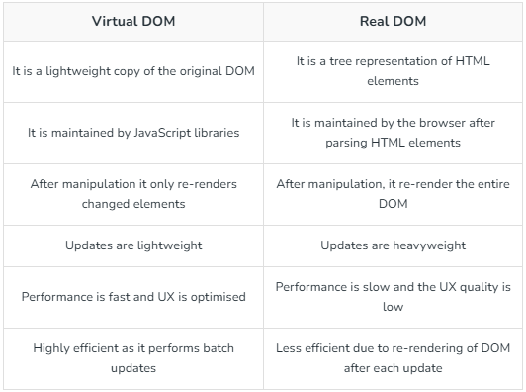
What is React JS? virtual dom ?
The Virtual DOM (VDOM) is a lightweight copy of the real DOM that React uses to improve performance. Instead of updating the actual DOM directly (which is slow), React updates the Virtual DOM first, calculates the differences, and then efficiently updates only the necessary parts of the real DOM.

Slide 4
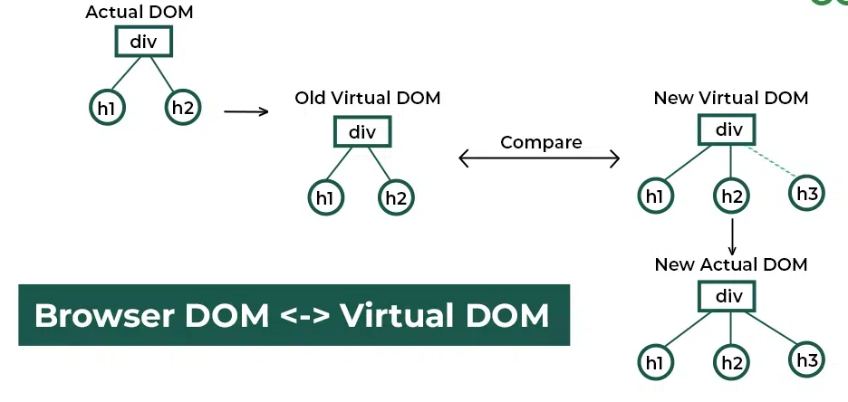
What is React JS? virtual dom ?

Slide 5
Why React ?
Fast & Efficient – Uses Virtual DOM for optimized rendering.
Component-Based – Build reusable, modular UI components.
Declarative Syntax – Write UI using JSX, making code more readable.
Strong Ecosystem – Large community, rich libraries, and tools.
Unidirectional Data Flow – Predictable state management.
Cross-Platform Development – Use React Native for mobile apps.
Easy State Management – Built-in useState, useReducer, plus tools like Redux, Zustand.
Backed by Meta (Facebook) – Well-maintained and widely used.

Slide 6
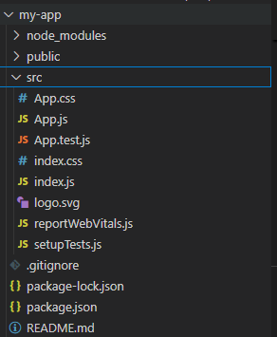
Create a Basic React App
Open vs Code terminal and run the script
npx create-react-app my-app
If any current execution policy restriction open PowerShell and reset the user state.
Set-ExecutionPolicy Unrestricted -Scope Process -Force
Again run the command (npx create-react-app my-app)

Slide 7
React JSX
JSX (JavaScript XML) is a syntax extension for JavaScript used in React to describe UI elements. It looks similar to HTML but is actually JavaScript under the hood. JSX makes it easier to create React components in a readable and declarative way.
return (
<div>
<h1>Title</h1>
<p>Paragraph</p>
</div>
);
Correct
return (
<h1>Title</h1>
<p>Paragraph</p>
);
Incorrect

Slide 8
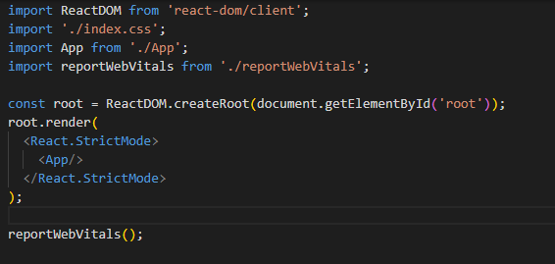
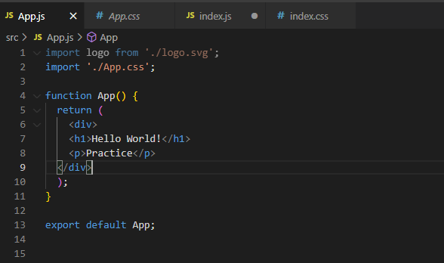
Rendering Multiple Elements

Slide 9
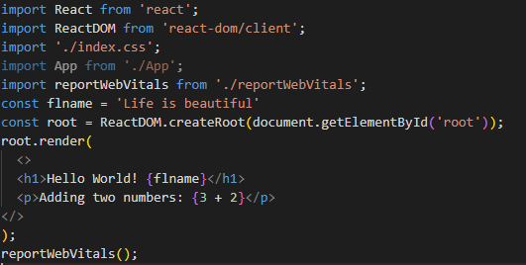
Expression in JSX
import React from 'react';
import ReactDOM from 'react-dom/client';
import './index.css';
import App from './App';
import reportWebVitals from './reportWebVitals';
const flname = 'Life is beautiful'
const root = ReactDOM.createRoot(document.getElementById('root'));
root.render(
<>
<h1>Hello World! {flname}</h1>
<p>Adding two numbers: {3 + 2}</p>
</>
);
reportWebVitals();

Slide 10
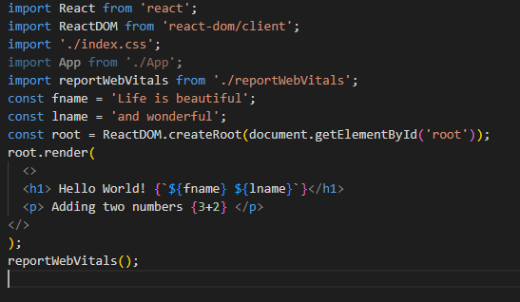
Template literals in JSX
import React from 'react';
import ReactDOM from 'react-dom/client';
import './index.css';
import App from './App';
import reportWebVitals from './reportWebVitals';
const fname = 'Life is beautiful';
const lname = 'and wonderful';
const root = ReactDOM.createRoot(document.getElementById('root'));
root.render(
<>
<h1> Hello World! {`${fname} ${lname}`}</h1>
<p> Adding two numbers {3+2} </p>
</>
);
reportWebVitals();

Slide 11
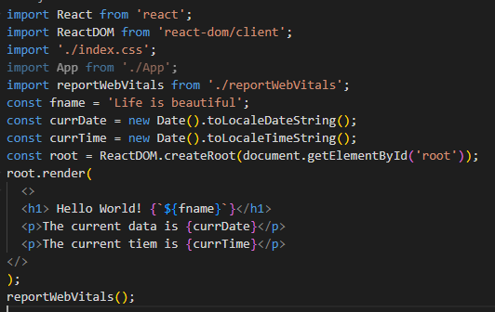
Current date and Time
import React from 'react';
import ReactDOM from 'react-dom/client';
import './index.css';
import App from './App';
import reportWebVitals from './reportWebVitals';
const fname = 'Life is beautiful';
const currDate = new Date().toLocaleDateString();
const currTime = new Date().toLocaleTimeString();
const root = ReactDOM.createRoot(document.getElementById('root'));
root.render(
<>
<h1> Hello World! {`${fname}`}</h1>
<p>The current data is {currDate}</p>
<p>The current tiem is {currTime}</p>
</>
);
reportWebVitals();

Slide 12
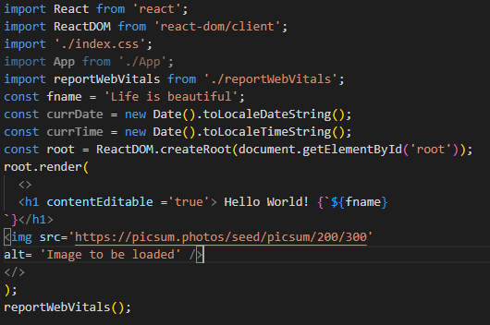

JSX Attributes in React

Slide 13
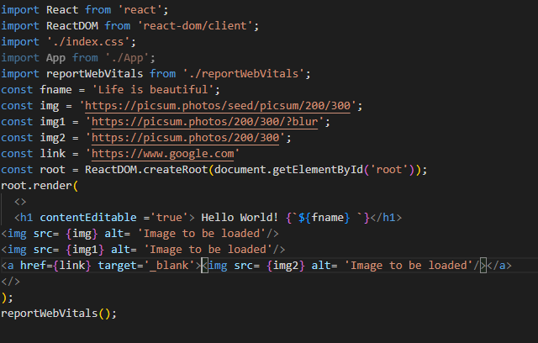
JSX Attributes in React

Slide 14
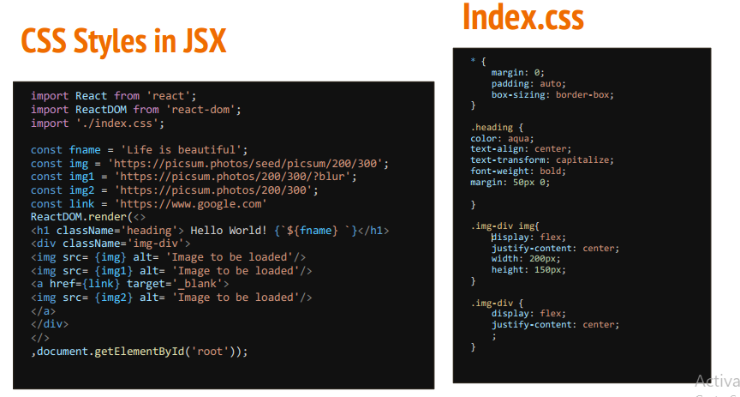
JSX Attributes in React

Slide 15
React Components
Components let you split the UI into independent, reusable pieces, and think about each piece in isolation.
Conceptually, components are like JavaScript functions. They accept arbitrary inputs (called “props”) and return React elements describing what should appear on the screen.
In next slides, creating functional component files ‘Heading.jsx’, ‘List.jsx’, and ‘Para.jsx’.

Slide 16
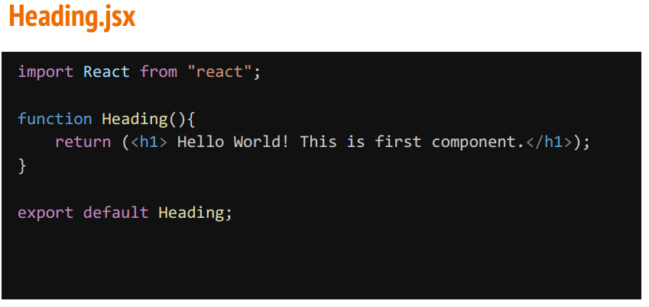
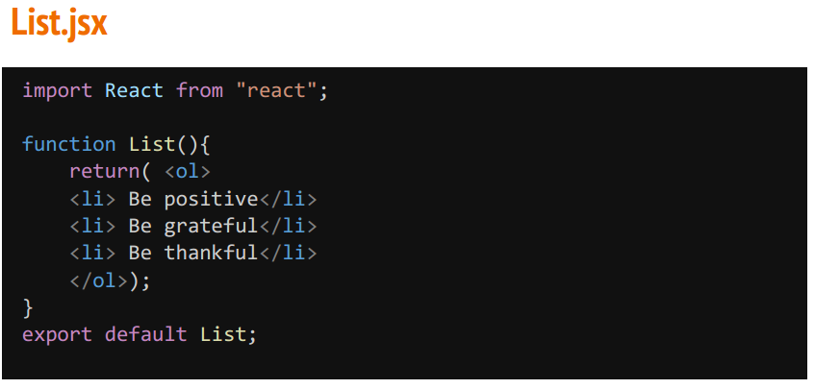
React Components

Slide 17
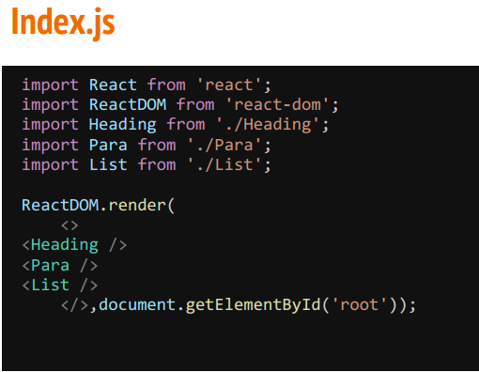
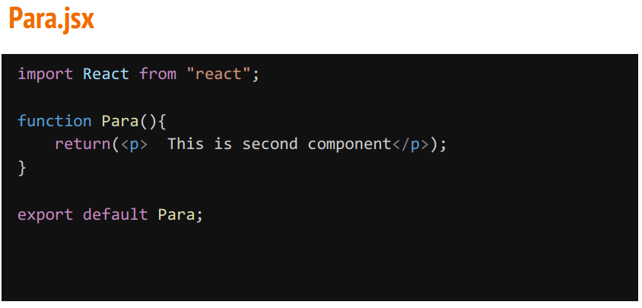
React Components

Slide 18
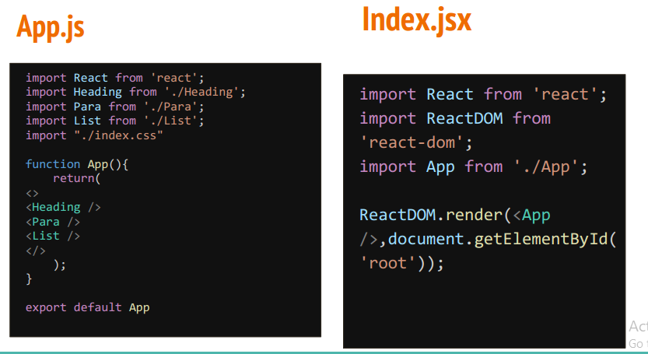
React Components

